Slide 1
Topics that are going to be covered…
Introduction to Web App Development • What is web / internet • What is web site • What is web page • What is web browser • What is web server • What is web technology • Client side web technologies (vs) server side web technologies

Slide 2
HTML Introduction Basic Tags Text Formatting Tags Lists Images Links Tables Forms Special Tags Head part DOCTYPE Designing website using div

Slide 3
CSS (Cascading style sheets)
Style sheet Introduction
Why we use style sheets
Types of CSS
Various selectors
Properties
Values of each property

Slide 4
Javascript
Introduction
Variables
DataTypes
Operators
Control Structures
Functions
Dialogue Boxes
HTML integration with Javascript
Validations using Javascript

Slide 5
jQuery • Intro to jQuery • Need of jQuery in real web sites • Advantages of jQuery • jQuery versions
jQuery Examples

Slide 6
What is web / internet?
The Internet is a vast network that connects computers all over the world. Through the Internet, people can share information and communicate from anywhere with an Internet connection.
What is web site
a set of related web pages located under a single domain name. • What is web page
web page. A document which can be displayed in a web browser such as Firefox, Google Chrome, Opera, Microsoft Internet Explorer or Edge, or Apple's Safari. • What is web browser
A web browser is a software application for accessing information on the World Wide Web. When a user requests a web page from a particular website,

Slide 7
HTML Introduction
HTML was developed by Sir Tim Berners-Lee in late 1991 but was not released officially, which was published in 1995 ‘s
HTML 2.0. HTML 4.01 was published in late 1999 and was a major version of HTML.
HTML5 is a markup language used for structuring and presenting content on the World Wide Web. It is the fifth and latest major version of HTML
HTML5 was first released in public-facing form on 22 January 2008, with a major update and "W3C Recommendation" status in October 2014.
The World Wide Web Consortium is the main international standards organization for the World Wide Web. Founded in 1994 and currently led by Tim Berners-Lee, the consortium is made up of member organizations that maintain full-time staff working together in the development of standards for the World Wide Web.

Slide 8
HTML stands for Hyper Text Markup Language
HTML is the standard markup language for creating Web pages
HTML describes the structure of a Web page
HTML consists of a series of elements
HTML elements tell the browser how to display the content
HTML elements label pieces of content such as "this is a heading", "this is a paragraph", "this is a link", etc.

Slide 9
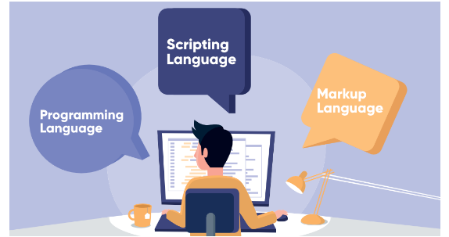
Programming language: In simple terms, programming languages are set of instructions or code which tells a computer what it needs to do. So basically, we provide a logic or instruction to the computer to perform some task to get the desired output from it.

Slide 10
Scripting Language: it’s all about giving the script to perform some certain task. Scripting languages are basically the subcategory of programming languages
Markup Languages: Markup languages are completely different from programming languages and scripting languages. Markup languages prepare a structure for the data or prepare the look or design of a page. These are presentational languages and it doesn’t include any kind of logic or algorithm

Slide 11
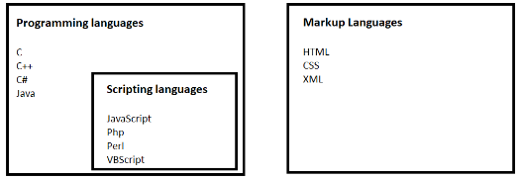

Slide 12
A Simple HTML Document
Syntax:
<!DOCTYPE html> <html> <head> <title>Page Title</title> </head> <body> </body> </html>

Slide 13
The <!DOCTYPE html> declaration defines that this document is an HTML5 document
The <!DOCTYPE> declaration represents the document type, and helps browsers to display web pages correctly.
It must only appear once, at the top of the page (before any HTML tags).
The <!DOCTYPE> declaration is not case sensitive.
The <html> element is the root element of an HTML page
The <head> element contains meta information about the HTML page
The <title> element specifies a title for the HTML page (which is shown in the browser's title bar or in the page's tab)
The <body> element defines the document's body, and is a container for all the visible contents, such as headings, paragraphs, images, hyperlinks, tables, lists, etc.

Slide 14
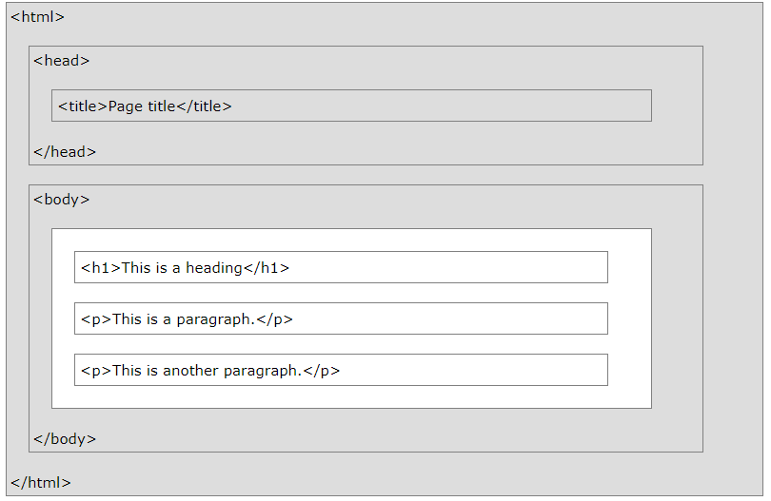
HTML Page Structure
Note: Only the content inside the <body> section (the white area above) will be displayed in a browser.

Slide 15
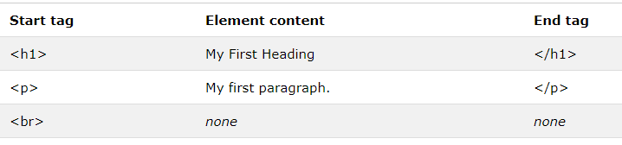
What is an HTML Element?
An HTML element is defined by a start tag, some content, and an end tag:
<tagname>Content goes here...</tagname>
The HTML element is everything from the start tag to the end tag:
<h1>My First Heading</h1>
<p>My first paragraph.</p>

Slide 16
HTML Headings
HTML headings are defined with the <h1> to <h6> tags.
<h1> defines the most important heading. <h6> defines the least important heading.
Example
<h1>Heading 1</h1> <h2>Heading 2</h2> <h3>Heading 3</h3> <h4>Heading 4</h4> <h5>Heading 5</h5> <h6>Heading 6</h6>

Slide 17
HTML Paragraphs
The HTML <p> element defines a paragraph.
A paragraph always starts on a new line, and browsers automatically add some white space (a margin) before and after a paragraph.
Example
<p>This is a paragraph.</p> <p>This is another paragraph.</p>

Slide 18
HTML Display
You cannot be sure how HTML will be displayed.
Large or small screens, and resized windows will create different results.
With HTML, you cannot change the display by adding extra spaces or extra lines in your HTML code.
The browser will automatically remove any extra spaces and lines when the page is displayed:
Example
<p> This paragraph contains a lot of lines in the source code, but the browser ignores it. </p> <p> This paragraph contains a lot of spaces in the source code, but the browser ignores it. </p>

Slide 19
HTML Formatting Elements
Formatting elements were designed to display special types of text:
<b> - Bold text
<b> tag is used to display the text in bold.
The text enclosed within the <b> tag will be display as bold.
Use <b> tag to display important text that you want to highlight.
It is a paired tag.
Syntax:
<b>bold text</b>
Example:
<b>Hello</b>

Slide 20
<strong>
<strong> tag is used to display the text in strong.
<strong> and <b> tags are visually same.
The strong tag content will be pronounced "strongly" (stressfully) by the screen readers for the blind people.
It is a paired tag.
Syntax:
<strong>strong text</strong>
Example:
<strong>Hello</strong>

Slide 21
<i> - Italic text
<i> tag is used to display the text in italic.
The text enclosed within the <i> tag will be display as italic.
It is a paired tag.
Syntax:
<i>italic text</i>
Example:
<i>Hello</i>

Slide 22
<mark> - Marked text
It is used to highlight the text
Example:<mark>hello</mark>
<del> - Deleted text
Used to delete the text simply stikeout the text
Example:<del>hello<del>
<ins> - Inserted text
Used to insert the text which is underlined automatically
Example:<ins><ins>

Slide 23
<sup> - Superscript text
<sup> tag is used to display the text in superscript (The text appears a bit upper side of normal line).
Syntax:
<sup>superscript text</sup>
Example:
<sup>Hello</sup>
<sub> - Subscript text
<sub> tag is used to display the text in subscript (The text appears a bit bottom side of normal line).
It is a paired tag.
Syntax: <sub>subscript text</sub>
Example:
<sub>Hello</sub>

Slide 24
<u> -Underline
<u> tag is used to display the text in underline.
The text enclosed within the <u> tag will be underlined.
Use <u> tag display important text.
It is a paired tag.
Syntax:
<u>underline text</u>
Example:
<u>Hello</u>

Slide 25
IMAGES
<img> tag is used to display an image in the web page.
It is strongly recommended to place the image file in the same folder, where the html file is present. For example, if the html file is present within "c:\html" folder, we have to place the image file either in the "c:\html" folder itself or in any subfolder of the "c:\html" folder.
It is an unpaired tag.
Syntax:
<img src="image path here">
Example:
<img src="img1.jpg" width="200px" height="130px" title="this is tooltip">

Slide 26
Attributes:
1. src: • It is used to specify path of the image file. If the image file and html file both are in the same folder, no need to specify the full path of the image.
2. width: • It is used to specify width (horizontal size) of the image. It represents the value in the form of pixels. A pixel is a small "dot" (.) on the screen.
3. height • It is used to specify height (vertical size) of the image.
4. title • It is used to specify the tooltip (that appears when the user places mouse pointer on the image).
5. alt • It is used to specify the alternate text (that appears when the image is not loaded in the browser at run time). It is strongly recommended to use "alt" for every <img>
tag in real-time, because, if the image is not loaded, at least the "alt" text appears to the user.

Slide 27
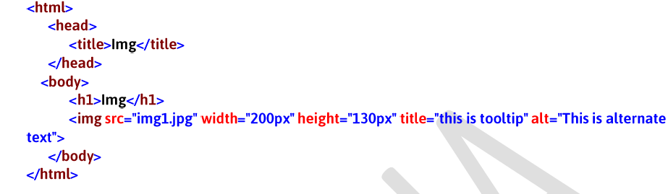
Example

Slide 28
HTML Comment Tags
You can add comments to your HTML source by using the following syntax:
<!-- Write your comments here -->
Notice that there is an exclamation point (!) in the start tag, but not in the end tag.
Note: Comments are not displayed by the browser, but they can help document your HTML source code.
With comments you can place notifications and reminders in your HTML code:
Example
<!-- This is a comment --> <p>This is a paragraph.</p> <!-- Remember to add more information here -->

Slide 29
Hyperlinks
<a> tag is used to create a hyperlink. When the user clicks on the hyperlink, the specified web page or web site or file will be opened.
The web basically contains links to other pages, so it is very common to use <a> tag in real-time.
By default, every browser provides built-in style for each hyperlink, i.e. blue color + hand symbol for mouse cursor + underline. We can customize this style by using CSS.
It is a paired tag.
Syntax:
<a href="target url here">link text here</a>
Example:
<a href="http://www.google.com">Google</a>

Slide 30
Attributes:
1. href: It is used to specify the address of web page or web site that is to be opened when the user clicks on the hyperlink. It can contain address of an internet web site, local html file, local other type of file such as pdf or word document, image file etc.
2. target="_blank": It is used to open the target web page or web site in a separate browser tab.

Slide 31
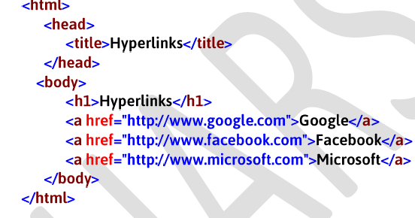
Example on internet links

Slide 32
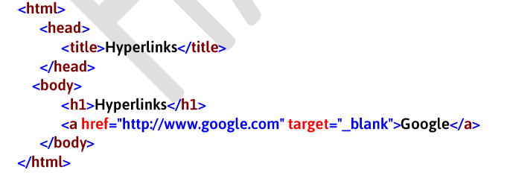
Example on target

Slide 33
Page navigation:
Us.html
<!doctype html>
<html>
<head>
<title>this is hypertext example
</title>
</head>
<body>
<h1>US</h1>
<a href="us.html">US</a>
<a href="uk.html">UK</a>
<a href="canada.html">CANADA</a>
<p>This is US</p>
</body>
</html>

Slide 34
Uk.html
<!doctype html>
<html>
<head>
<title>this is hypertext example
</title>
</head>
<body>
<h1>uk</h1>
<a href="us.html">us</a>
<a href="uk.html">uk</a>
<a href="canada.html">canada</a>
<p>this is uk</p>
</body>
</html>

Slide 35
Canada.html
<!doctype html>
<html>
<head>
<title>this is hypertext example
</title>
</head>
<body>
<h1>canada</h1>
<a href="us.html">us</a>
<a href="uk.html">uk</a>
<a href="canada.html">canada</a>
<p>this is canada </p>
</body>
</html>

Slide 36
LIST TAG
Unordered List
• <ul> tag is used to display the list of items with bullets.
• UL stands for “Un-Ordered List”.
• Inside <ul> tag, you should place one or more <li> tags. <li> tag stands for "List Item", which represents a single item in the list.
• Use <ul> tag if you want to display any names such as person names, country names, city names etc.
• It is a paired tag.

Slide 37
us.html
Unordered List
Syntax:
<ul>
<li>text here</li>
<li>text here</li>
…
</ul>
Example:
<ul>
<li>India</li>
<li>UK</li>
<li>US</li>
</ul>

Slide 38
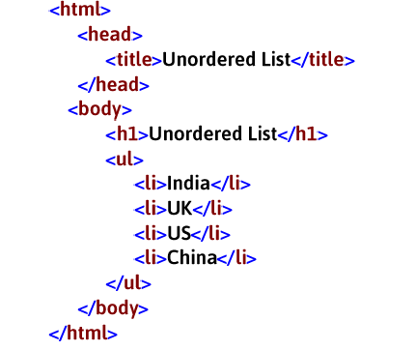
EXAMPLE ON UI

Slide 39
Ordered list:
OL stands for “Ordered List”.
• It is used to display the list of items with numbers.
• Inside <ol> tag, you should place one or more <li> tags. The <li> tag represents a single item in the list.
• Use <ol> tag if you want to display names with numbers. For example, list of academic subjects (in order).
• It is a paired tag.

Slide 40
Syntax:
<ol>
<li>text here</li>
<li>text here</li>
…
</ol>
Example:
<ol>
<li>India</li>
<li>UK</li>
<li>US</li>
</ol>

Slide 41
Definition list
DL stands for “Definition List”.
• <dl> tag is used to display a collection of definitions.
• Inside <dl> tag, you should place one or more <dt> and <dd> tags.
• It is a paired tag.
• <dt> and <dd> tags are also paired tags. DT stands for "Definition Title".
• <dt> is used to specify definition title.
• <dd> is used to specify actual definition. DD stands for "Definition Data".

Slide 42
Syntax:
<dl>
<dt>title here</dt>
<dd>definition here</dd>
<dt>title here</dt>
<dd>definition here</dd>
…
</dl>
Example:
<dl>
<dt>Computer</dt>
<dd>Computer definition here</dd>
<dt>Car</dt>
<dd>Car definition here</dd>
</dl>

Slide 43
TABLE
Table Tag:
<table> tag is used to display table type of data in the web page.
• A table is a collection of rows. Each row is a collection of cells.
• A table is represented as <table> tag; A row is represented as <tr>; A cell is represented as <td>.
• Inside the <table> tag, we have to use <tr>; Inside the <tr> tag, we have to use <td>.
• If the cell is representing the column heading, you can use <th> tag, instead of <td> tag.
• <caption> tag is used to specify a title for the table.
• “tr” stands for “Table row”.
• “td” stands for “Table data”.
• “th” stands for “Table header”.
• <table>, <tr>, <th>, <td> and <caption> tags are paired tags.

Slide 44
Syntax:
<table>
<tr>
<td>data here</td>
<td>data here</td>
…
</tr>
…
</table>
Example:
<table border="1">
<tr>
<td>One</td>
<td>Two</td>
</tr>
<tr>
<td>Three</td>
<td>Four</td>

Slide 45
</tr>
<tr>
<td>Five</td>
<td>Six</td>
</tr>
</table>

Slide 46
HTML Entities
HTML Entities are pre-defined codes for displaying special symbols within the web page.
HTML Entities are case sensitive. These must be used in lower case only.

Slide 47
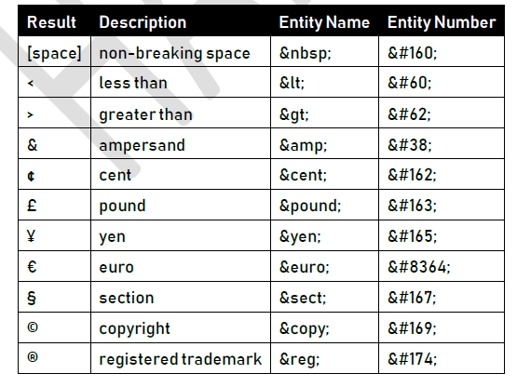

Slide 48
DIV tag
<div> is a container.
• Inside <div> tag you can place any content like normal text or any other html tags.
• When you want to divide your web page as no. of parts, each part is represented as <div> tag.
• <div> is a paired tag.
Syntax:
<div>
Your content here
</div>
Example:
<div>
Hello
</div>

Slide 49
<!doctype html>
<html>
<head>
<title>table
</title>
</head>
<body >
<div align='left' style='background-color:red; width:100%;height:100px'><h1>this is my
1st div tag</h1>
</div>
<div align='center' style='background-color:white; width:100%;height:100px'><h1>this is
my 2nd div tag</h1>
</div>
</div>
<div align='right' style='background-color:green; width:100%;height:100px'><h1>this is my
3rd div tag</h1>
</div>
</div>
</body>
</html>

Slide 50
Span tag
<span> represents a small amount of text, for which you can apply some special formatting.
• <span> tag doesn't provide any style by default, but we can apply style to the span tag, by using CSS.
• <span> is a paired tag.
Syntax:
<span>Your content here</span>
Example:
<span>Hello</span>

Slide 51
<!doctype html>
<html>
<head>
<title>table
</title>
</head>
<body >
<span style='color:orange'>this is html</span>
<span style='color:yellow'>this is html</span>
<span style='color:green'>this is html</span>
</body>
</html>

Slide 52
HTML FORMS
What is HTML Form : HTML Form is a document which stores information of a user on a web server using interactive controls.
An HTML form contains different kind of information such as username, password, contact number, email id etc.
The elements used in an HTML form are check box, input box, radio buttons, submit buttons etc.
Using these elements the information of an user is submitted on a web server.
The form tag is used to create an HTML form.

Slide 53
<!DOCTYPE html>
<html>
<body>
<form>
<label>username</label>
<input type ="text" name="uname"><br><br>
<lable>password</label>
<input type="password" name="pwd"><br>
<input type="submit" value="submit">
</form>
</body>
</html>

Slide 54
CSS
(Cascading Style Sheets)

Slide 55
What is CSS?
CSS stands for “Cascading Style Sheet”.
• CSS is a “styling language”, which is used to apply styles to the html elements in the web page.
• CSS styles include with backgrounds, colors, margins, borders, paddings, alignments etc.
• A CSS style can overlap other CSS style; that's why it is called as "cascading" style sheets.
CSS saves a lot of work. It can control the layout of multiple web pages all at once

Slide 56

Syntax of CSS :

Slide 57
CSS Basic Selectors
• “Select” is a syntax to select the desired elements.
• CSS supports many selectors. The most important css selectors are:
1. Tag Selector
2. ID Selector
1. Tag Selector
• The “tag selector” selects all the instances of specific tag.
• Use tag selector to select multiple elemens.
Syntax: tagname
Example: p

Slide 58
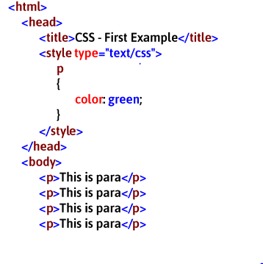

Slide 59
2. ID Selector
• The “id selector” selects a single tag, based on the “id”.
• “ID” is the “identification name”; it must be unique.
• Use ID selector to select a exact single element.
"#" is the symbol of "ID".
Syntax: #id
Example: #p1

Slide 60
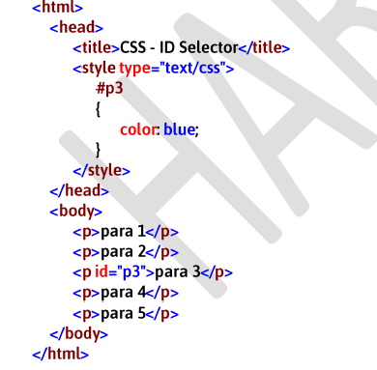

Slide 61
Why Use CSS?
CSS is used to define styles for your web pages, including the design, layout and variations in display for different devices and screen sizes.
CSS Example
bg{ background-color: lightblue; } h1 { color: white; text-align: center; } p { font-family: verdana; font-size: 20px; }

Slide 62
CSS Solved a Big Problem
HTML was created to describe the content of a web page, like:
<h1>This is a heading</h1>
<p>This is a paragraph.</p>
When tags like <font>, and color attributes were added to the HTML 3.2 specification, it started a nightmare for web developers. Development of large websites, where fonts and color information were added to every single page, became a long and expensive process.
To solve this problem, the World Wide Web Consortium (W3C) created CSS.
CSS removed the style formatting from the HTML page!

Slide 63
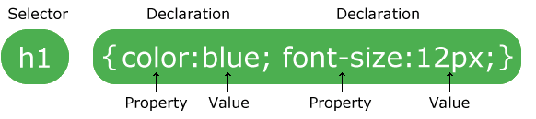
CSS Syntax
A CSS rule-set consists of a selector and a declaration block:
The selector points to the HTML element you want to style.
The declaration block contains one or more declarations separated by semicolons.
Each declaration includes a CSS property name and a value, separated by a colon.
Multiple CSS declarations are separated with semicolons, and declaration blocks are surrounded by curly braces.

Slide 64
color
• This property specifies text color (font color) of the element.
• You can specify any color of your choice.
Syntax: color: colorname;
Example: color: green;
background-color
• This property specifies background color of the element.
• You can set any color as background color.
Syntax: background-color: colorname;
Example: background-color: green;

Slide 65
font-family
This property specifies name of the font. You refer the font family names from notepad.
It is recommended to specify multiple font family names; if specified browser tries the subsequent font if the previous font is not found / not supported in the browser.
Syntax: font-family: “fontname”;
Example: font-family: “Arial”;

Slide 66
font-size
This property specifies size of the font.
You can specify the font size in the form of pixels / percentage .
Syntax: font-size: pixels;
Example: font-size: 30px;
Font-weight
This property applies bold.
The default value is "normal".
If the value is "normal", the text appears normally.
If the value is "bold", the text appears thick (bold).
Syntax: font-weight: normal | bold;
Example: font-weight: bold;

Slide 67
font-style
This property applies italic.
The default value is "normal".
If the value is "normal", the text appears normally.
If the value is "italic", the text appears italic.
Syntax: font-style: normal | italic;
Example: font-style: italic;

Slide 68
text-align This property specifies alignment for the text.
The default value is "left".
Syntax: text-align: left | right | center | justify;
Example: text-align: left;
SPAN
<span> represents a small amount of text, for which you can apply some special formatting.
<span> is a paired tag.
<span> tag doesn't apply any style by default; but we can apply any style for it.
Syntax:
<span>Your content here</span>
Example:
<span>Hello</span>

Slide 69
background-image
This property specifies background image of the element.
It is recommended to place the background image file in the current folder.
background-image
Syntax:
background-image:url(‘filename.extension’);
Example: background-image: url(‘sample.jpg’);

Slide 70
background-repeat
• This property specifies repeat mode of the background image.
• The default value is "repeat".
• If the value is "no-repeat", the background image will not be repeated; will be displayed only once at top left corner.
background-repeat
Syntax: background-repeat: repeat | no-repeat ;
Example: background-repeat: no-repeat;

Slide 71
background-attachment
This property specifies whether the background image should be scrolled along with the text, when the user uses the scrollbars of the web page.
If the value is "scroll", the background image will be scrolled along with the text.
If the value is "fixed", the background image will not be scrolled along with the text; Only the text will be scrolled; background image will be constantly appears.
Syntax: background-attachment: scroll | fixed;
Example: background-attachment: scroll;

Slide 72
DIV
<div> is the most important tag of html.
<div> tag represents a division (part) of the page.
<div> is a container, in which you can place any other elements.
A web page can have any no. of <div> tags.
<div> is a paired tag.
<div> is a block level element. That means it occupies 100% of the width, by default. So the content next to the <div> tag, appears in the next line.
<div> tag
Syntax: <div> any content </div>
Example: <div> Hello </div>

Slide 73
width” property
This property specifies horizontal size of the element.
You can specify the value in the form of pixels or percentages.
Syntax: width: pixels;
Example: width: 200px;
“height” property
This property specifies vertical size of the element.
You can specify the value in the form of pixels or percentages.
Syntax: height: pixels;
Example: height: 100px;

Slide 74
CSS Animations
An animation lets an element gradually change from one style to another.
You can change as many CSS properties you want, as many times you want.
To use CSS animation, you must first specify some keyframes for the animation.
Keyframes hold what styles the element will have at certain times.
The @keyframes Rule
When you specify CSS styles inside the @keyframes rule, the animation will gradually change from the current style to the new style at certain times.
To get an animation to work, you must bind the animation to an element.
The following example binds the "example" animation to the <div> element. The animation will last for 4 seconds, and it will gradually change the background-color of the <div> element from "red" to "yellow":

Slide 75
<!DOCTYPE html>
<html>
<head>
<style>
div {
width: 100px;height: 100px;
background-color: red;
animation-name: example;
animation-duration: 4s;
}
@keyframes example {
from {background-color: red;}
to {background-color: yellow;}
}
</style>
</head>

Slide 76
<body>
<p><b>Note:</b> This example does not work in Internet Explorer 9 and earlier versions.</p>
<div></div>
<p><b>Note:</b> When an animation is finished, it changes back to its original style.</p>
</body>
</html>

Slide 77
The Difference Between Inline, External and Internal CSS Styles
Internal CSS
Internal or embedded CSS requires you to add <style> tag in the <head> section of your HTML document.
This CSS style is an effective method of styling a single page. However, using this style for multiple pages is time-consuming as you need to put CSS rules to every page of your website.
Here’s how you can use internal CSS:
Open your HTML page and locate <head> opening tag.
Put the following code right after the <head> tag
<style type="text/css">

Slide 78
Add CSS rules on a new line. Here’s an example:
body
{
background-color: blue;
}
h1
{
color: red;
}
Type the closing tag:
</style>

Slide 79
Your HTML file will look like this:
<!DOCTYPE html>
<html>
<head>
<style>
body
{
background-color: blue;
}
h1 {
color: red; padding: 60px;
}
</style>
</head>
<body>
<h1>Hostinger Tutorials</h1>
<p>This is our paragraph.</p>
</body>
</html>

Slide 80
External CSS
With external CSS, you’ll link your web pages to an external .css file, which can be created by any text editor in your device (e.g., Notepad++).
This CSS type is a more efficient method, especially for styling a large website. By editing one .css file, you can change your entire site at once.

Slide 81
Follow these steps to use external CSS:
Create a new .css file with the text editor, and add the style rules. For example:
div
{
width: 33%;
Height:40%;
background-c0lor:red;
Color:green;
}

Slide 82
In the <head> section of your HTML sheet, add a reference to your external .css file right after <title> tag:
<link rel="stylesheet" type="text/css" href="style.css" /> Don’t forget to change style.css with the name of your .css file.

Slide 83
Inline CSS
Inline CSS is used to style a specific HTML element. For this CSS style, you’ll only need to add the style attribute to each HTML tag, without using selectors.
This CSS type is not really recommended, as each HTML tag needs to be styled individually. Managing your website may become too hard if you only use inline CSS.
However, inline CSS in HTML can be useful in some situations. For example, in cases where you don’t have access to CSS files or need to apply styles for a single element only.

Slide 84
Let’s take a look at an example. Here, we add an inline CSS to the <p> and <h1> tag:
<!DOCTYPE html>
<html>
<body style="background-color:black;">
<h1 style="color:white;padding:30px;">Hostinger Tutorials</h1>
<p style="color:white;">Something usefull here.</p> </body>
</html>
Internal or embedded ⁠— add <style> tag in the <head> section of HTML document
External — link the HTML sheet to a separate .css file
Inline — apply CSS rules for specific elements.

Slide 85
JAVASCRIPT
Introduction to JavaScript
• JavaScript is a Scripting language, which is used to create functionality in the web page. Functionality means, “receiving inputs from the user and providing output to the user”.
• It can perform tasks such as calculations, decision making, repetitive tasks, dynamically displaying the output, reading inputs from the user dynamically, updating content on the web page based on the inputs, interacting with server, validations etc.
• It’s operators and control statements are similar to “C” language.
• JavaScript is client-side (browser-side) language. That means it executes on the browser. It can also be used in server by using NodeJS.
• JavaScript is a case sensitive language.
• JavaScript is “interpreter-based” language. That means the code will be converted into machine language, line-by-line.

Slide 86
JavaScript was developed by “Netscape Corporation” in 1996.
• JavaScript is the implementation of "EcmaScript". "EcmaScript" is the specification of "JavaScript".
• "EcmaScript" is designed by "Ecma International".

Slide 87
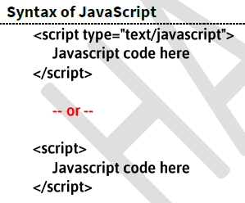

Slide 88
Sample exmple:
<html>
<head>
<script type="text/javascript" >
document.write("welcome to js");
</script>
</head>
<body>
</body>
</html>

Slide 89
Variables
Variable is a “named memory location” in RAM, to store a value temporarily, while executing the program.
In JavaScript, the variables will be persisted (stored), while the web page is running in the browser.
The value of variable can be changed any no. of times during the web page execution.
The data type of the variable can be changed any no. of times during the web page execution, in JavaScript.
Syntax:
var variablename=value;
Ex: var a=10;
var name=“james”;

Slide 90
Operators:
Operator is a symbol, which represents an operation.
• JavaScript supports the following types of operators. 1. Arithmetical Operators
2. Assignment Operators
3. Increment and Decrement Operators
4. Relational Operators
5. Logical Operators
6. Concatenation Operator

Slide 91
Arithmetical Operators
+ Addition
- Subtraction
* Multiplication
/ Division
% Remainder
EXAMPLE PROGRAM
<html>
<head>
<script type="text/javascript" >
var a=10;
var b=20;
var c=a+b;
var d=a-b;
document.write("the sum of two no:",+"<br>");
document.write("the sub of two no:",d);
</script>
</head>
<body>
</body>
</html>

Slide 92
Assignment Operators
= Assigns to
+= Add and assigns to
-= Subtract and assigns to
*= Multiply and assigns to
/= Divide and assigns to
%= Remainder and assigns to

Slide 93
<html>
<head>
<script type="text/javascript" >
var a=10;
b=a;
document.write(a+"<br>");
a+=100;
document.write(a);
</script>
</head>
<body>
</body>
</html>

Slide 94
Increment and Decrement Operators
++ Increment (+=1)
-- Decrement (-=1)
<html>
<head>
<script type="text/javascript" >
var a=10;
document.write(a+"<br>");
a++;
document.write(a+"<br>");
--a;
document.write(a+"<br>");
</script>
</head>
<body>
</body>
</html>

Slide 95
Relational Operators
== Equal to
!= Not Equal to
< Less than
> Greater than
<= Less than or equal to
>= Greater than or equal to

Slide 96
<html>
<head>
<script type="text/javascript" >
var a=10;
var b=20;
var c=(a==b)
document.write(c+"<br>");
</script>
</head>
<body>
</body>
</html>

Slide 97
Logical Operators
&& And (both conditions should be true)
|| Or (At least any one condition should be true)
<html>
<head>
<script type="text/javascript" >
var a=10;
var b=20;
var c=30;
var d=((a<=b)&&(b<=c))
document.write(d)
</script>
</head>
<body>
</body>
</html>

Slide 98
Concatenation Operator
+ Attaches two strings and returns a single string.
Ex: “United” + “States” = “Unitedstates”
Number + Number = addition
String + String = concatenation
String + Number = concatenation
Number + String = concatenation

Slide 99
Control Statements
control statements cause the flow of execution to advance and branch based on the changes to the state of the program.
Selection statements allow the program to choose different parts of the execution based on the outcome of an expression
The Java script if statement is used to test the condition. It checks boolean condition: true or false. There are various types of if statement in Java.
if statement
if-else statement
if-else-if ladder
nested if statement

Slide 100
if Statement
The Java if statement tests the condition. It executes the if block if condition is true.
Syntax:
if(condition){
//code to be executed
}
if-else Statement
The if-else statement also tests the condition. It executes the if block if condition is true otherwise else block is executed.
Syntax:
if(condition){
//code if condition is true
}else{
//code if condition is false
}

Slide 101
if-else-if ladder Statement
The if-else-if ladder statement executes one condition from multiple statements.
Syntax:
if(condition1){
//code to be executed if condition1 is true
}else if(condition2){
//code to be executed if condition2 is true
}
else if(condition3){
//code to be executed if condition3 is true
}
...
else{
//code to be executed if all the conditions are false
}

Slide 102
Nested if statement
The nested if statement represents the if block within another if block. Here, the inner if block condition executes only when outer if block condition is true.
Syntax:
if(condition){
//code to be executed
if(condition){
//code to be executed
}
}

Slide 103
Iteration statements enable program execution to repeat one or more statements
For Loop
The for loop is used to iterate a part of the program several times. If the number of iteration is fixed, it is recommended to use for loop. A simple for loop is the same as C/C++. We can initialize the variable, check condition and increment/decrement value. It consists of 3 parts:
Initialization: It is the initial condition which is executed once when the loop starts. Here, we can initialize the variable, or we can use an already initialized variable. It is an optional condition.
Condition: It is the second condition which is executed each time to test the condition of the loop. It continues execution until the condition is false. It must return boolean value either true or false. It is an optional condition.
Statement: The statement of the loop is executed each time until the second condition is false.
Increment/Decrement: It increments or decrements the variable value. It is an optional condition.
Syntax:
for(initialization;condition;incr/decr){
//statement or code to be executed }
}

Slide 104
While Loop
The while loop is used to iterate a part of the program several times. If the number of iteration is not fixed, it is recommended to use while loop.
Syntax:
while(condition){
//code to be executed
}

Slide 105
do-while Loop
The do-while loop is used to iterate a part of the program several times. If the number of iteration is not fixed and you must have to execute the loop at least once, it is recommended to use do-while loop.
The do-while loop is executed at least once because condition is checked after loop body.
Syntax:
do{
//code to be executed
}while(condition);

Slide 106
JavaScript Functions
A function is a sub program which is used to perfrom some specific operation.
Steps to declare a function:
1.Declare the function
2.Call the function
Syntax:
Function functionname()
{
//statements
}

Slide 107
Note:It is always recommended to declare a function in head tag and calling the function in body tag.
Example:
Function Add()
{
//stmts
}

Slide 108
JavaScript Form Validation
HTML form validation can be done by JavaScript.
Validation is a process of checking the form input values, whether those are correct or not.
• If all the form input values are correct, then we will allow the form to be submitted to the server.
• If any one of the form input values are incorrect, then we will stop submitting the form and display appropriate error message to the user.
• Validations are done using JavaScript.
Common Examples of Validations:
1. The value can’t be blank.
2. The value should be in the proper format. Ex: phone number, email etc.

Slide 109
JavaScript Dialogue Boxes
JavaScript has three kind of Dialogue boxes:
1.Alert box
2. Confirm box
3.Prompt box.
Alert Box
An alert box is often used if you want to make sure information comes through to the user.
When an alert box pops up, the user will have to click "OK" to proceed.
syntax
alert("sometext");

Slide 110
Confirm box
A confirm box is often used if you want the user to verify or accept something.
When a confirm box pops up, the user will have to click either "OK" or "Cancel" to proceed.
If the user clicks "OK", the box returns true. If the user clicks "Cancel", the box returns false.
window.confirm("sometext");

Slide 111
Prompt Box
A prompt box is often used if you want the user to input a value before entering a page.
When a prompt box pops up, the user will have to click either "OK" or "Cancel" to proceed after entering an input value.
If the user clicks "OK" the box returns the input value. If the user clicks "Cancel" the box returns null.
Syntax:
prompt("sometext","defaultText");

Slide 112
JQUERY
Introduction to Jquery
The purpose of jQuery is to make it much easier to use JavaScript on your website.
What You Should Already Know
Before you start studying jQuery, you should have a basic knowledge of:
HTML
CSS
JavaScript

Slide 113
What is jQuery?
jQuery is a lightweight, "write less, do more", JavaScript library.
The purpose of jQuery is to make it much easier to use JavaScript on your website.
jQuery takes a lot of common tasks that require many lines of JavaScript code to accomplish, and wraps them into methods that you can call with a single line of code.

Slide 114
The jQuery library contains the following features:
CSS manipulation
HTML event methods
Effects and animations
AJAX
Utilities

Slide 115
Why jQuery?
There are lots of other JavaScript libraries out there, but jQuery is probably the most popular, and also the most extendable.
Many of the biggest companies on the Web use jQuery, such as:
Google
Microsoft
IBM
Netflix

Slide 116
<!DOCTYPE html>
<html>
<head>
<script src="https://ajax.googleapis.com/ajax/libs/jquery/3.5.1/jquery.min.js"></script>
<script>
$(document).ready(function(){
$("p").click(function(){
$(this).hide();
});
});
</script>
</head>
<body>
<p>If you click on me, I will disappear.</p>
<p>Click me away!</p>
<p>Click me too!</p>
</body>
</html>

